Slide 1

의료정보학시스템
Profiling FHIR
Dept. of Computer Science & Engineering
College of IT
Kyungpook National University
2017.09.11.

Slide 2
What is Profiling
The base FHIR specification describes a set of base resources, frameworks and APIs that are used in many different contexts in healthcare.
However, there is wide variability between jurisdictions and across the healthcare ecosystem around practices, requirements, regulations, education and what actions are feasible and/or beneficial.

Slide 3
What is Profiling
For this reason, the FHIR specification is a "platform specification" - it creates a common platform or foundation on which a variety of different solutions are implemented.
As a consequence, this specification usually requires further adaptation to particular contexts of use. Typically, these adaptations specify:
Rules about which resource elements are or are not used, and what additional elements are added that are not part of the base specification
Rules about which API features are used, and how
Rules about which terminologies are used in particular elements
Descriptions of how the Resource elements and API features map to local requirements and/or implementations

Slide 4


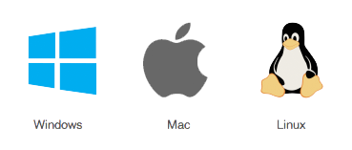
What is Profiling
Note that because of the nature of the healthcare ecosystem, there may be multiple overlapping sets of adaptations - by healthcare domain, by country, by institution, and/or by vendor/implementation.

Slide 5
Profiling Artifacts
Implementation Guide (IG)
A coherent and bounded set of adaptations that are published as a single unit. Validation occurs within the context of the Implementation Guide
Package
A group of related adaptations that are published as a group within an Implementation Guide
Conformance Resource
A single resource in a package that makes rules about how an implementation works. These are described below
*The term "profile" is a general one that is used about either a "package" or an "item". "Profiling" is a general term that describes the process of creating an implementation guide, or any of the conformance resources found in one.

Slide 6
Conformance Resources
Comformance Resource
Capability Statement
Indicate some API calls
OperationDefinition and SearchParameter
Add additional operations or search parameters not in the base specification
StuctureDefinition
Describe how existing elements in resources are used
Identify existing elements that are not used
Define extensions that can be used in resources or data types
ConceptMap
Describe custom and standard terminologies
NamingSystem
Register system namespaces for identifiers and terminologies
DataElement
Describe and register in a Data Dictionary specific Data Elements that are used across systems

Slide 7
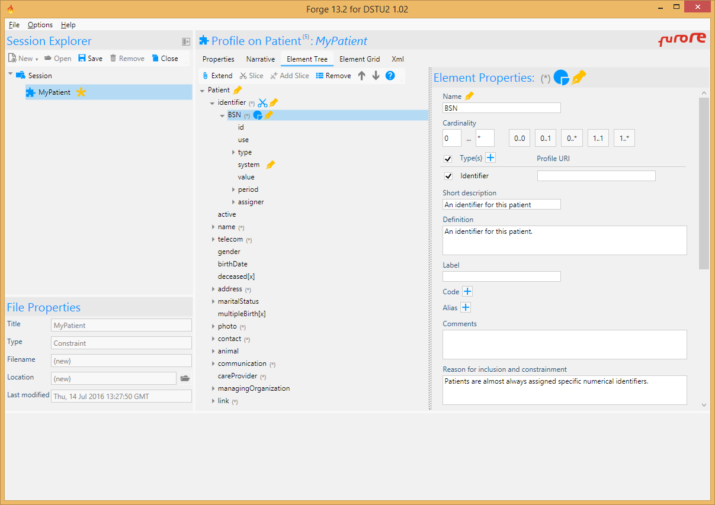
Forge
FHIR profiling tool.

Slide 8
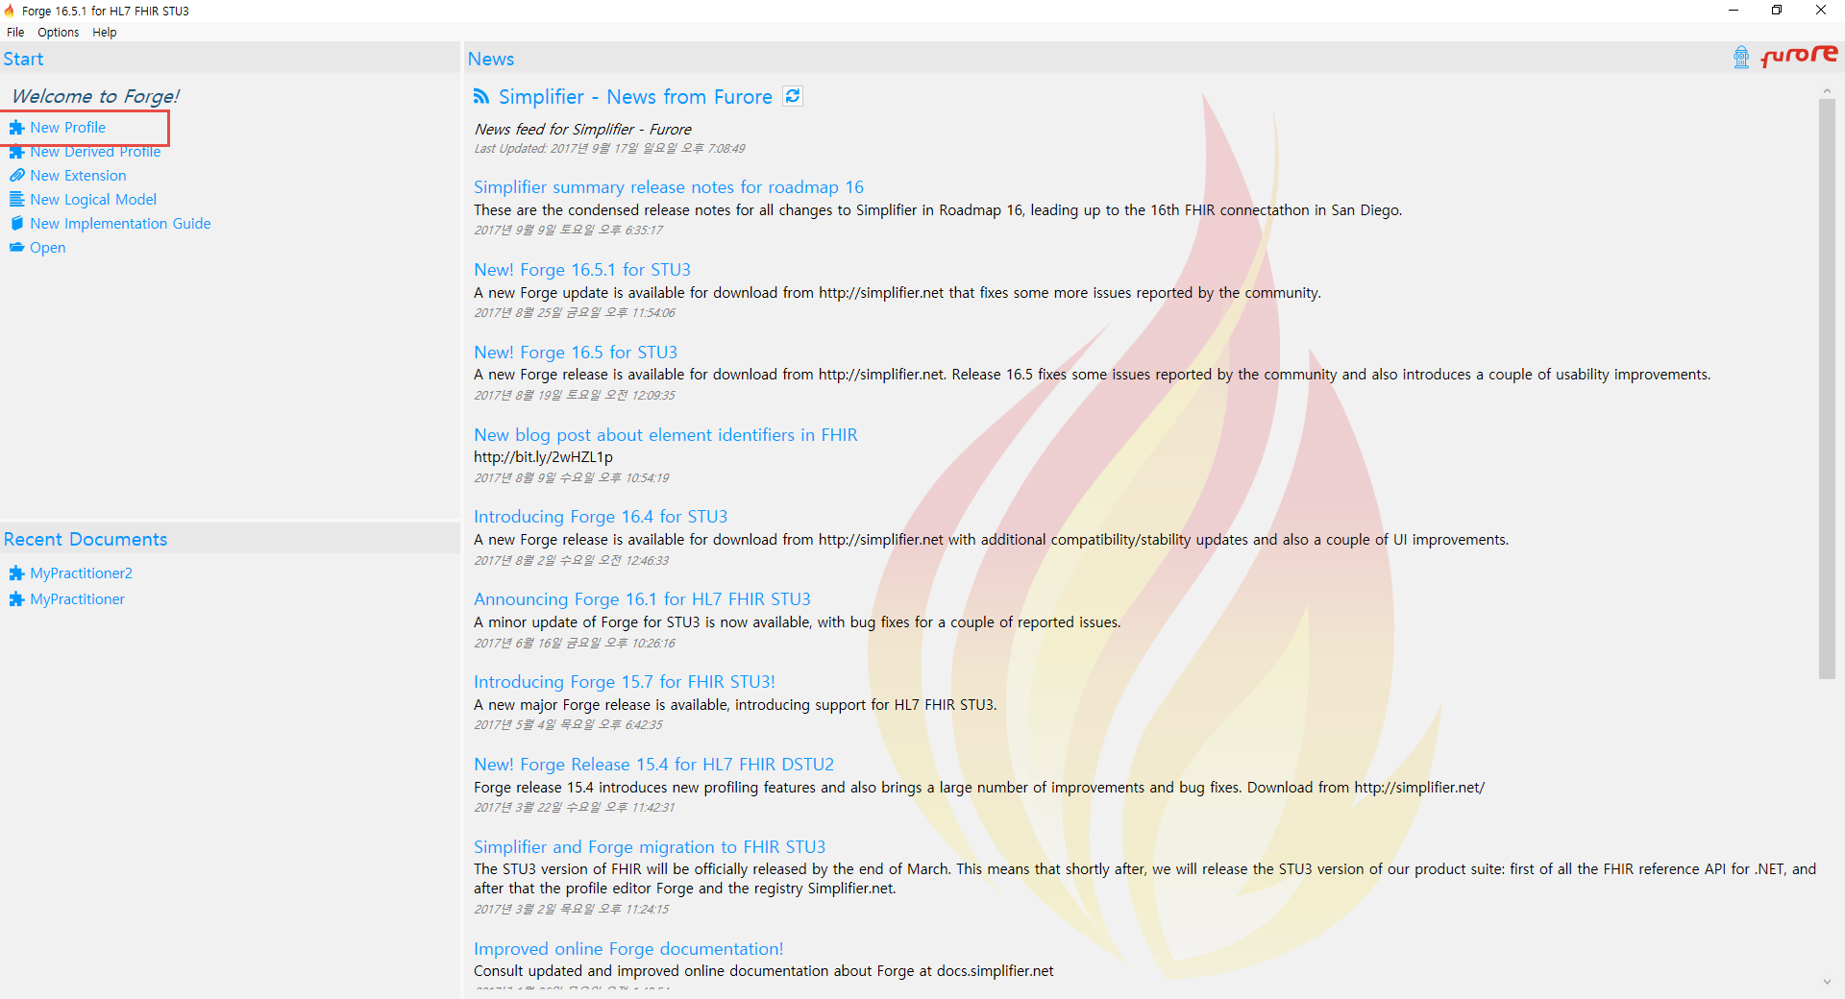
Making StructureDefinition using Forge

Slide 9
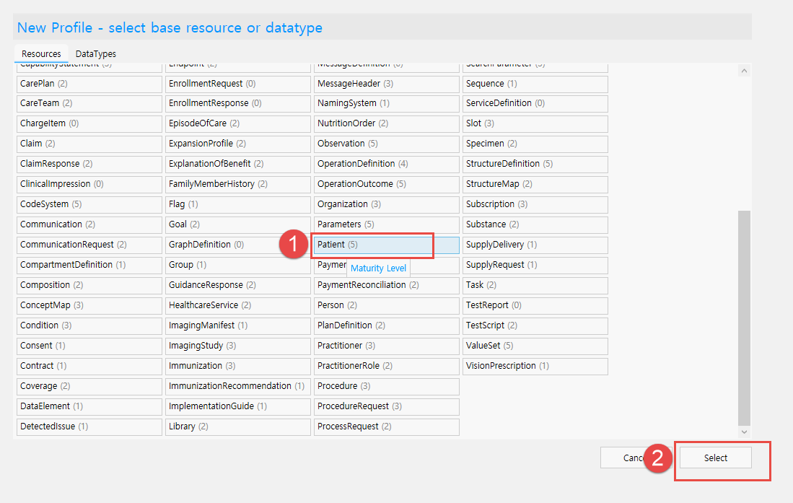
Making StructureDefinition using Forge

Slide 10
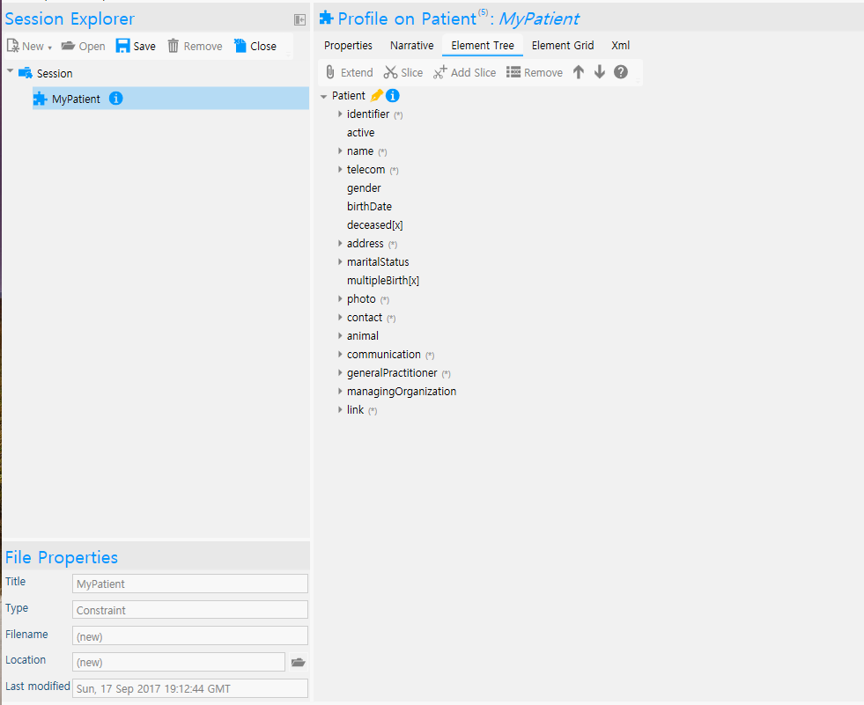
Making StructureDefinition using Forge

Slide 11
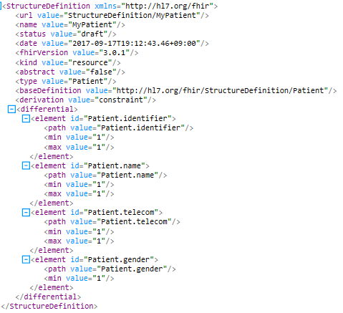
Making StructureDefinition using Forge

